Slide 1
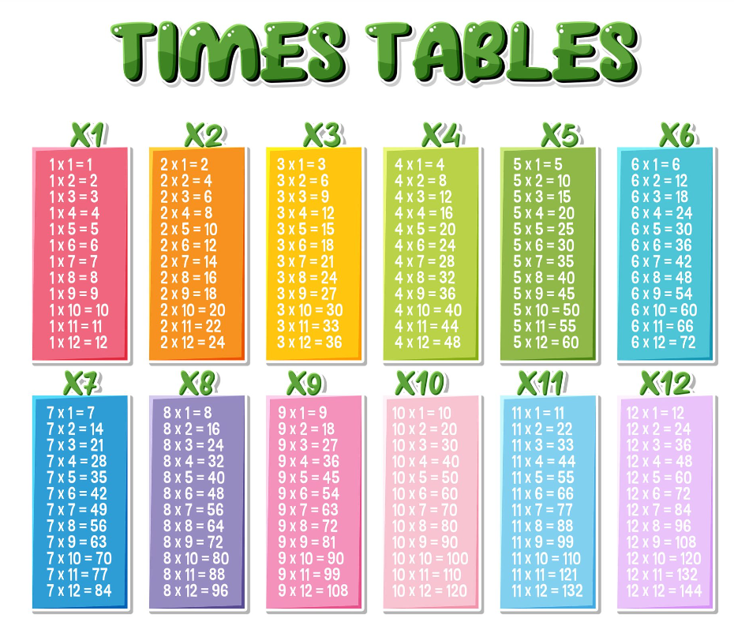
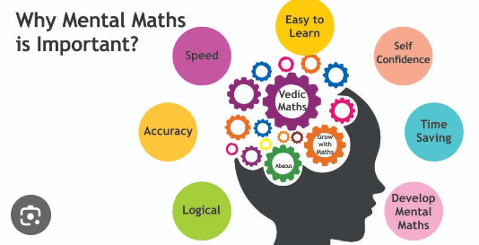
Why learn how to multiply?
Multiplication is commonly used in our everyday lives. For example, we can calculate the price of the items according to the rate per quantity, we can find the correct quantity of the ingredient to be used in cooking, we can calculate the value of multiple items when the value of 1 item is known, and so on.
Many mathematical skills require pupils to be able to multiply, it will make maths much easier in the years to come.

Slide 2
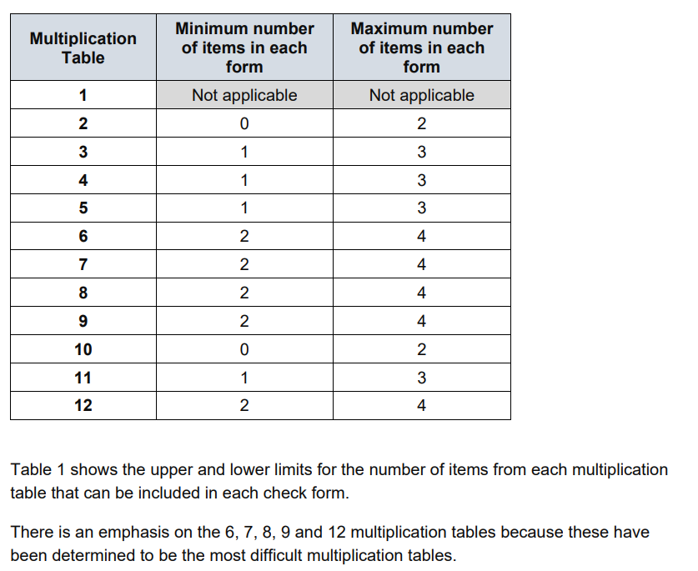
What is the Multiplication Tables Check
The Multiplication Tables Check (MTC) is a key stage 2 assessment to be taken by pupils at the end of year 4 (in June). The MTC’s purpose is to ensure the times tables knowledge is at the expected level. In the 2024/2025 academic year, the multiplication tables check (MTC) is statutory for primary schools.
The Multiplication Times Tables Check is an online test where the pupils are asked 25 questions on times tables 2 to 12. For every question, you have 6 seconds to answer, and in between the questions, there is a 3-second rest. Questions about the 6, 7, 8, 9, and 12 times table come up more often. The questions are generated randomly based on the rules of the MTC.

Slide 3
How to prepare
A good way to prepare is to start early and build a daily routine practising the times tables. With regular practise you will learn all the questions and gain confidence. We suggest practising 10 minutes a day for optimal results.
This can be split up throughout a day/evening.
For example
⅔ minutes in morning just after breakfast.
4/5 minutes in car or walk home.
4/5 minutes before dinner.

Slide 4
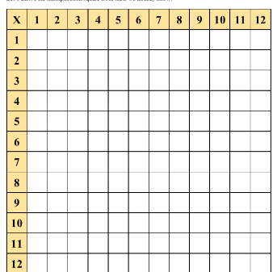
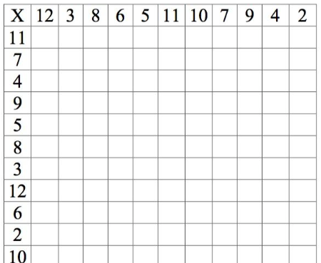
The 4-step plan
Learn the times tables with the 5-step plan. We developed an innovative five step plan to help pupils learn the times tables in an effective and efficient way. This method has been tested at several schools and is recommended by teachers.
The steps are:
Step 1: View, read aloud and repeat. To get familiar with the table.
Step 2: Fill in your times tables answers in sequence and check if you got them all right.
Step 3: Fill in your answers for the mixed questions and check if you got them all right.
Step 4: Multiple choice questions will help you to improve by looking at the questions in a different way.
.
You may not want to complete all five steps in one sitting.
If your child is unfamiliar with a particular times table, they may need to focus on steps one and two.
These steps can be used online with websites such as TTRS or on paper.

Slide 5
When is the check?
In 2025, schools must administer the MTC to all eligible year 4 pupils between Monday 2 June and Friday 13 June.
Schools can use the following week, Monday 16 June to Friday 20 June, to administer the check to any pupils who were absent during the first 2 weeks or in case of any delays to the administration of the check due to technical difficulties.
We will able to do official practice tests from the last week in april, however pupils should have a good knowledge of times tables before then.

Slide 6
Useful websites
https://mathsframe.co.uk/en/resources/resource/477/Multiplication-Tables-Check
https://www.timestables.co.uk/multiplication-tables-check/
https://ttrockstars.com/#:~:text=Times%20Tables%20Rock%20Stars%20is,recall%20in%20multiplication%20and%20division.

Slide 7


