Slide 1
Lubbins Park Primary Academy
Homework Guide 2018

Slide 2
Homework Club
Homework club is help every Monday during lunch time where pupils can be supported through homework by a teacher if needed.
Homework club can be used to complete homework on that day as it is set or to catch up on any outstanding pieces from the week before.
In addition to this, the school library is open daily where the pupils can take out a laptop and complete their homework if they wish.
Homework is set every Monday and due in the following Monday.

Slide 3
Website addresses
www.readtheory.org
www.ttrockstars.com
www.spag.com
www.spellingshed.com
www.mymaths.co.uk
All logins are in your child’s purple Home/School diary – any issues with logins, please write to the class teacher via the home diary and they will solve these for you.

Slide 4
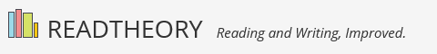
www.readtheory.org

Slide 5
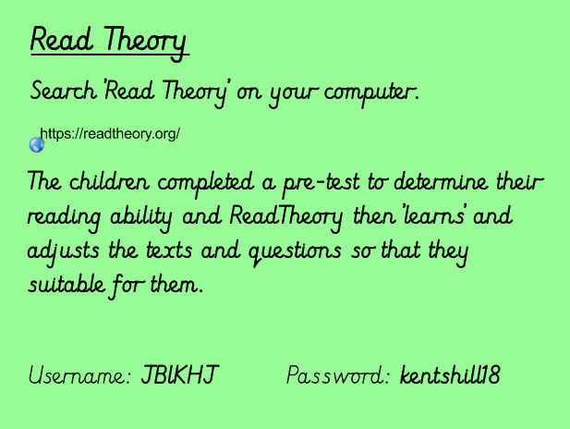

Slide 6
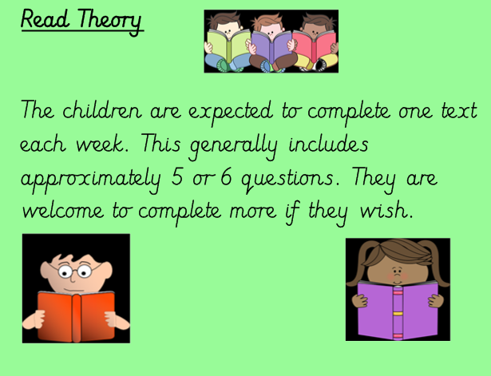

Slide 7
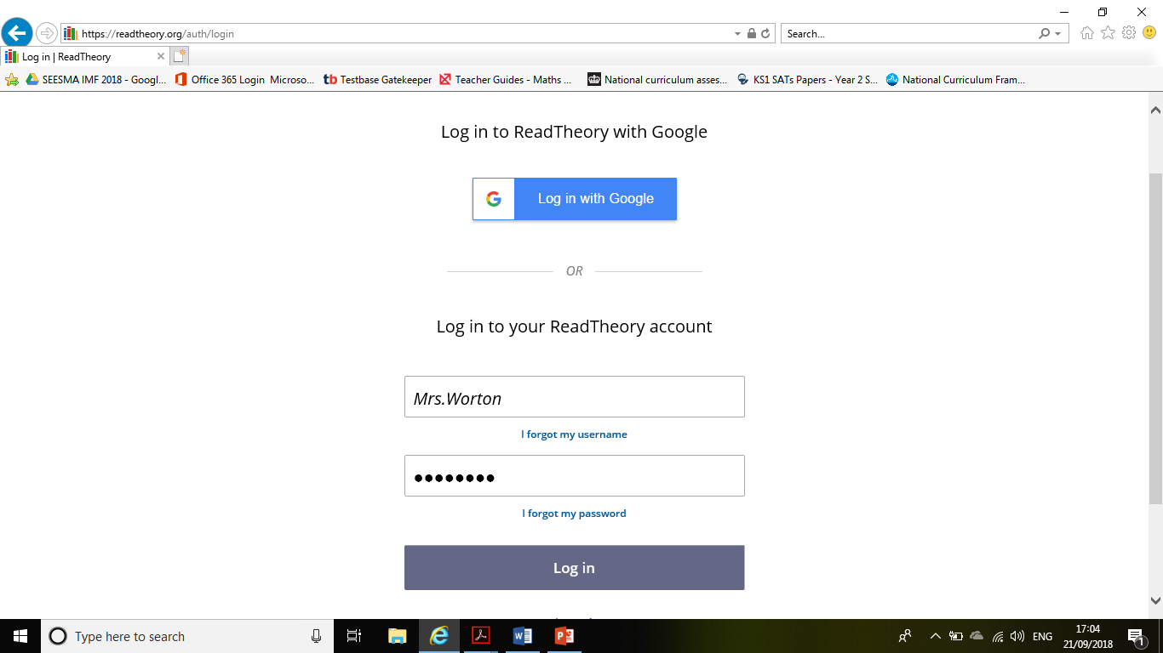
Logging in:
Enter username and password
Click login

Slide 8
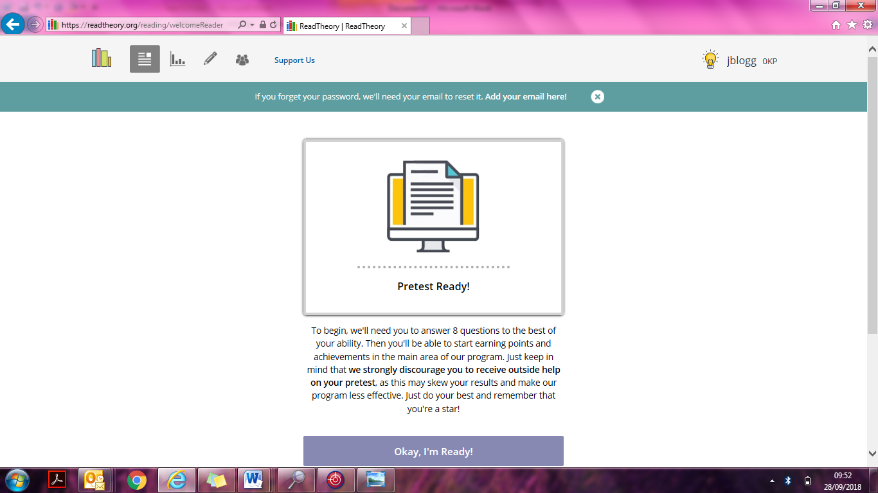
The first time of using ReadTheory each pupil will sit a pretest quiz. The questions on this range from easier to very challenging – this is to ensure that the quiz fully tests each pupils ability to pitch the starting quizzes at. From there, ReadTheory ‘learns’ every time a pupil completes a quiz and adjusts accordingly.

Slide 9
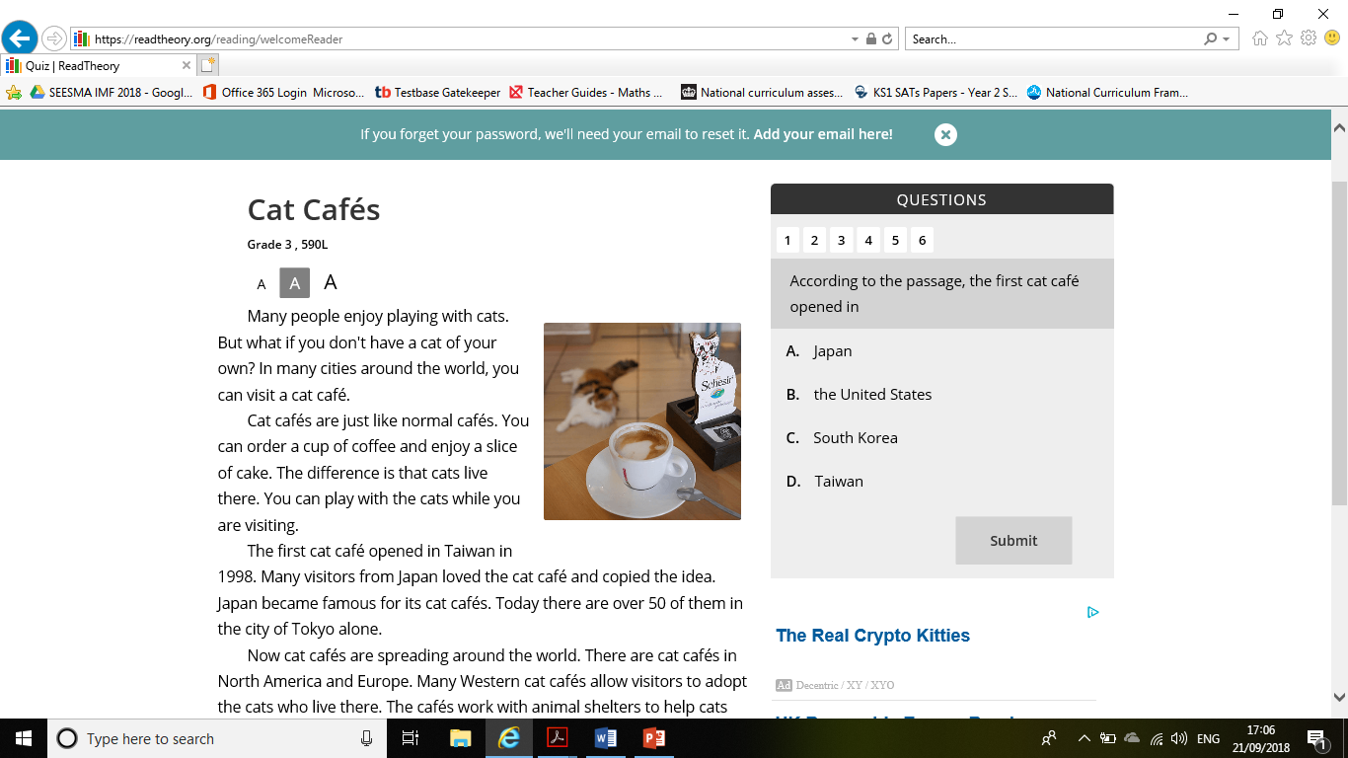
Every other time:
once logged in, you will be given a series of questions at the appropriate level (based on the baseline assessment completed).
The expectation is for each child to complete one of these quizzes each week.

Slide 10
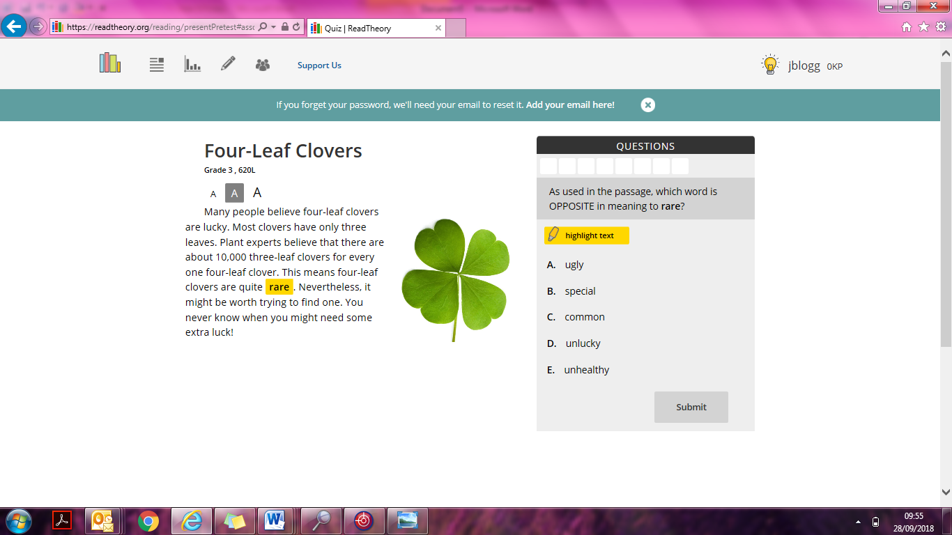
On some questions there is the option to ‘highlight’ the text, once clicked, it allows the pupil to see exactly which section of the text the question refers to.

Slide 11
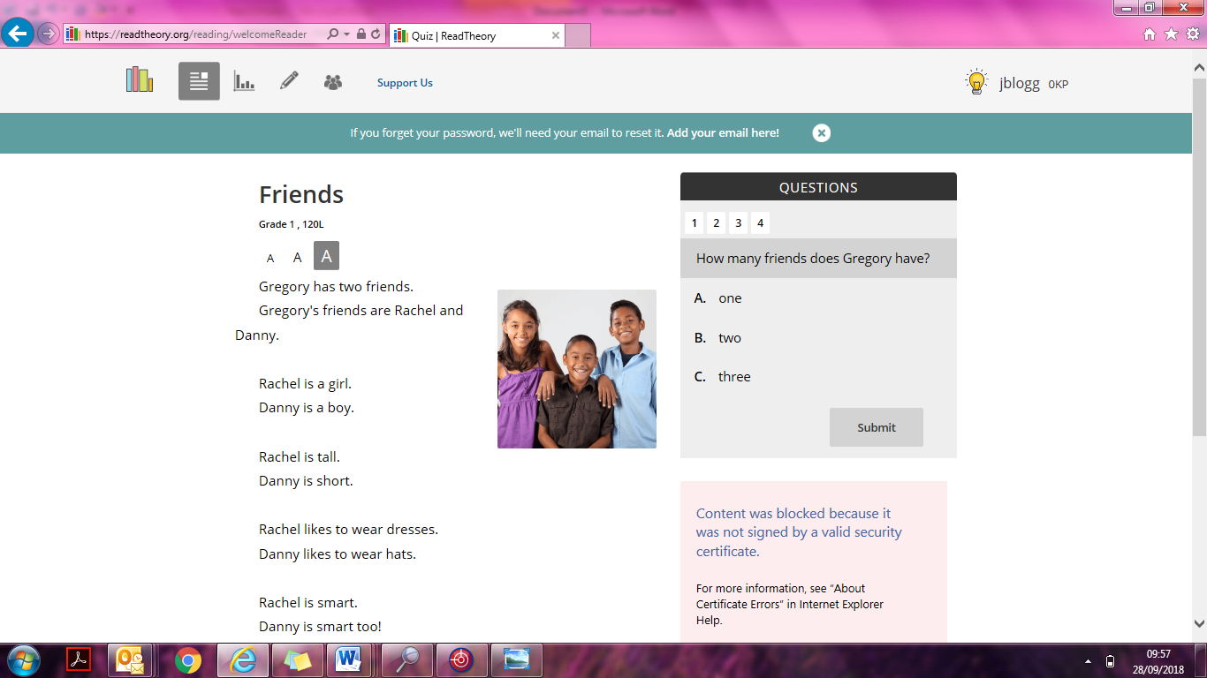
You can make the text bigger or smaller by clicking on these icons.

Slide 12
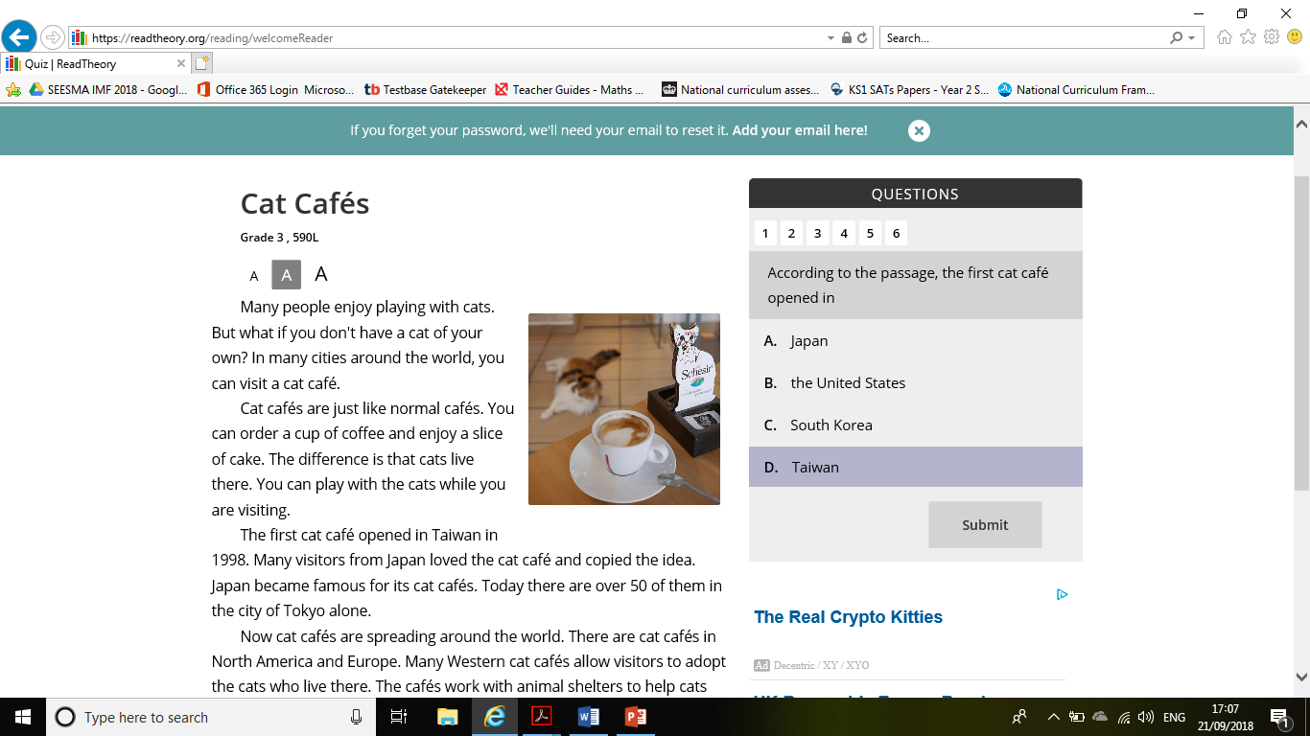
Once the text has been read, choose the correct answer and click “Submit”

Slide 13
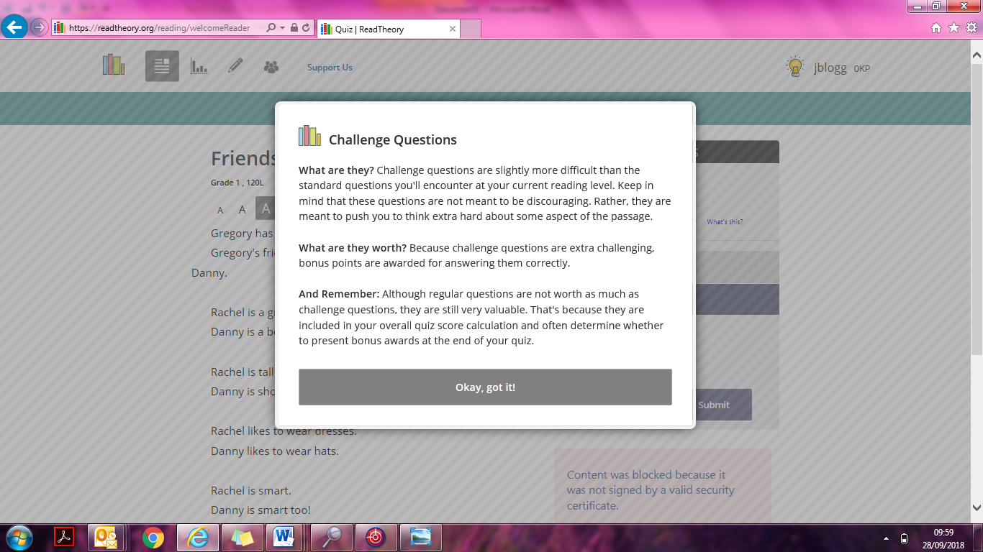
Each round of questions comes with ‘Challenge questions’ as explained here.

Slide 14
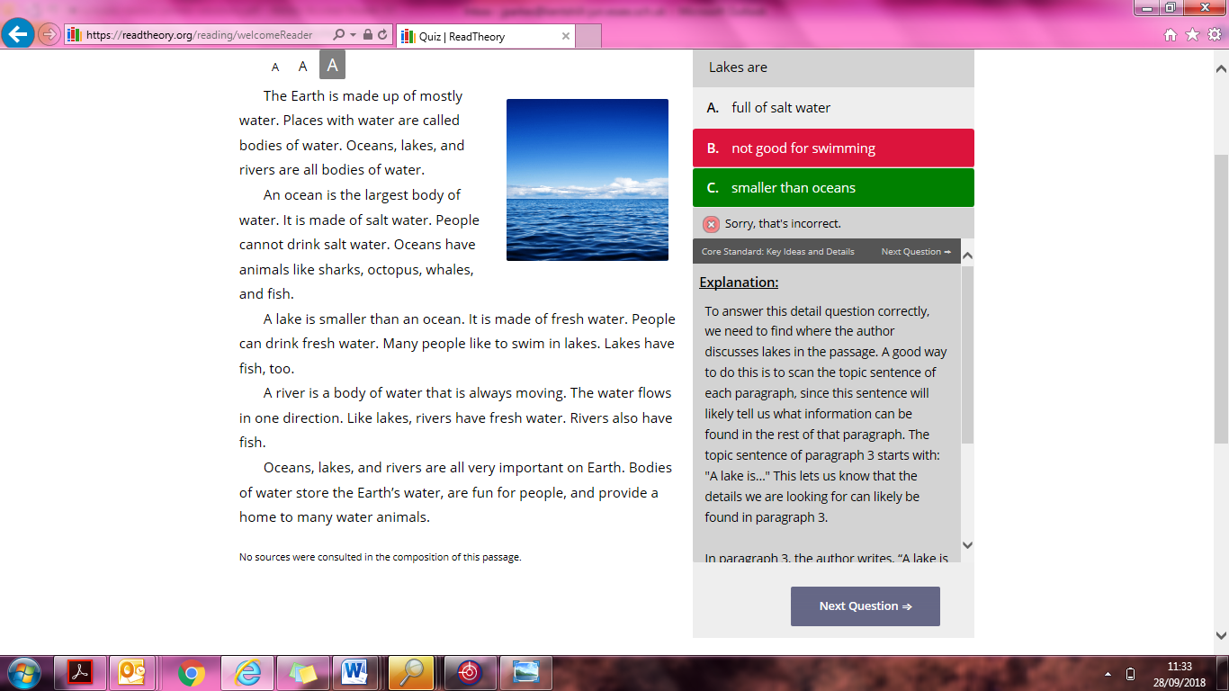
If an answer is incorrect, an explanation will appear to explain where the answer could have been found and explains it to the pupil as their teacher would.

Slide 15
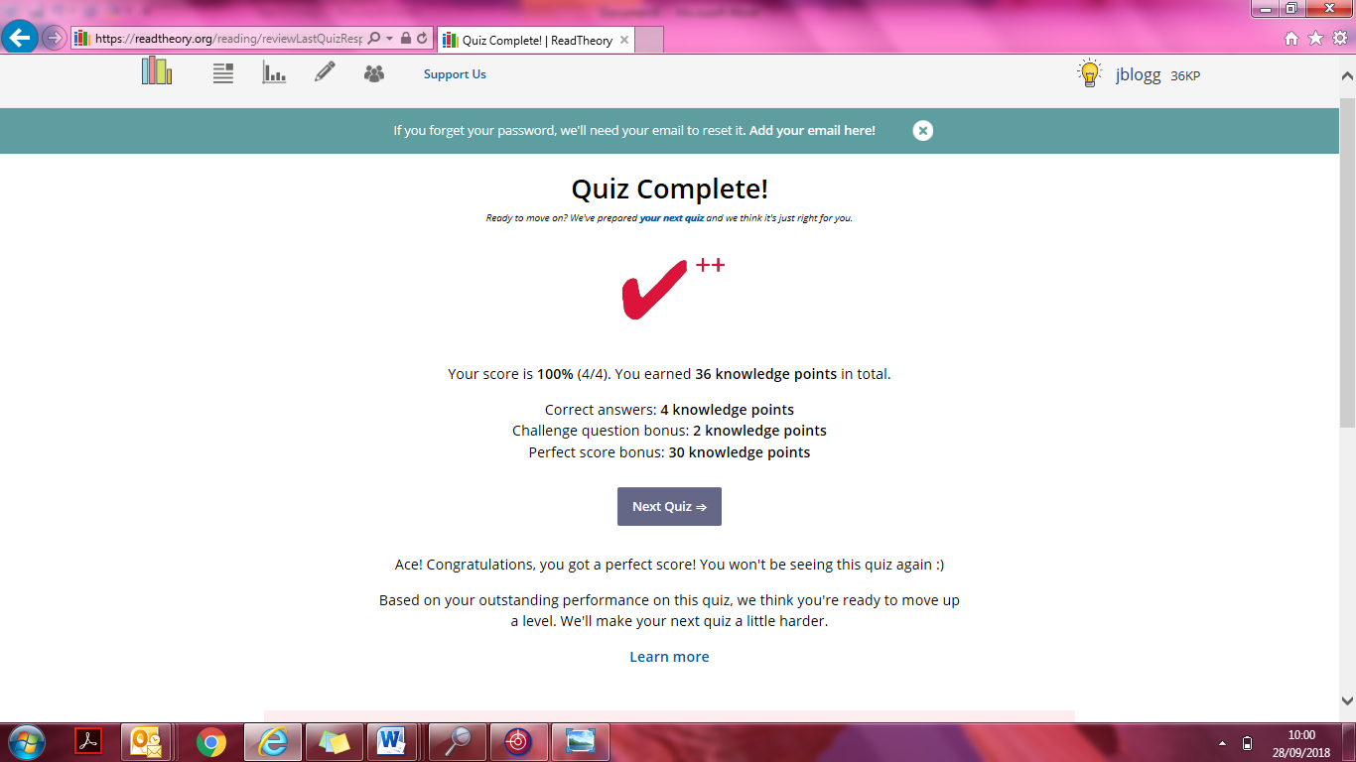
ReadTheory is always ‘learning’ therefore if a pupil gains full marks, the next quiz becomes harder. This may be the text or it may be the style of questioning that changes.

Slide 16
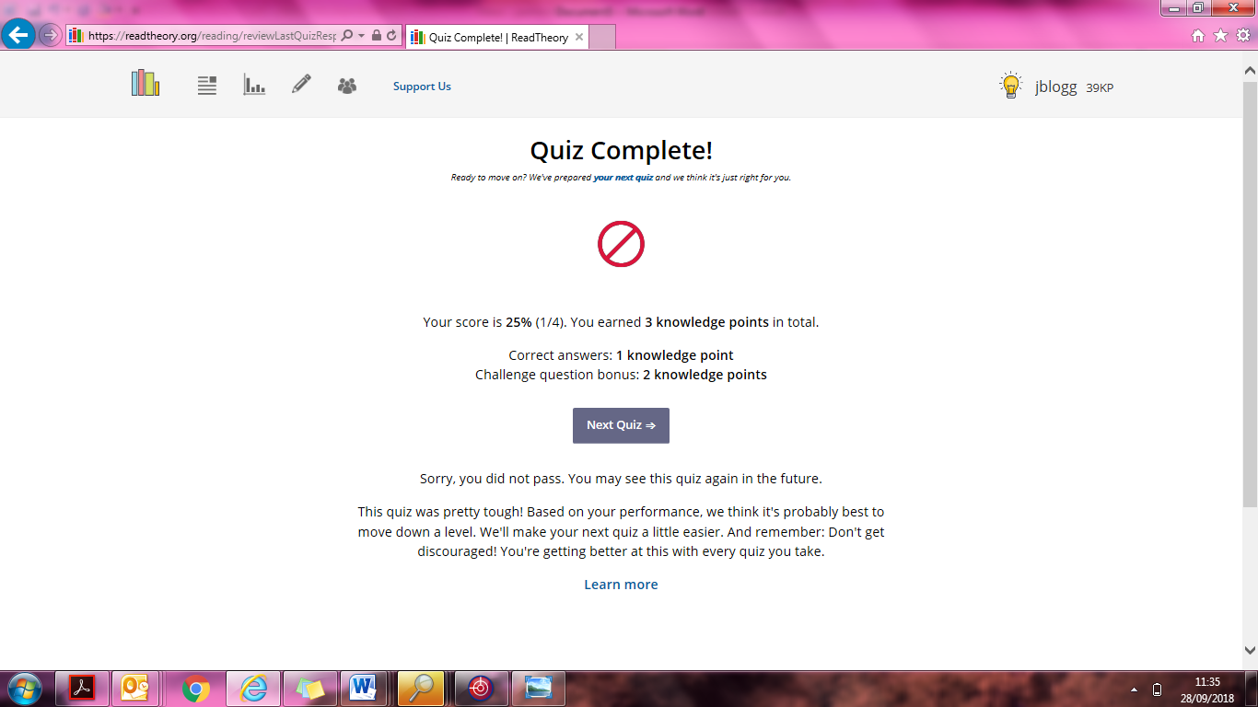
Equally, if a quiz was a little too challenging, the next quiz will be made a little easier. If it’s a certain type of question that is often incorrect, the quiz will focus on those question types.
Beware: Readtheory can tell if it thinks you have read the text too quickly or are just clicking answers to complete a quiz without fully attempting them, at this point it will temporarily lock you out so that your teacher can see where you may need help.

Slide 17
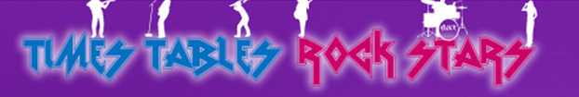
www.ttrockstars.com

Slide 18
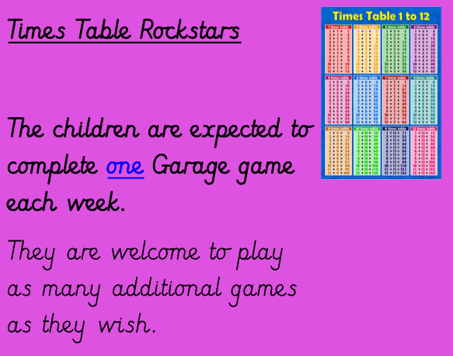

Slide 19
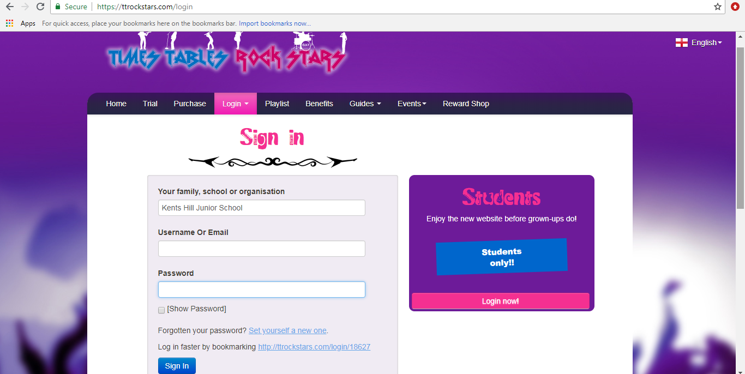
Go to www.ttrockstars.com/login and ensure you are logging in as a student.
You will be asked to enter the school name “Kents Hill Junior School” before putting in the username and password.

Slide 20
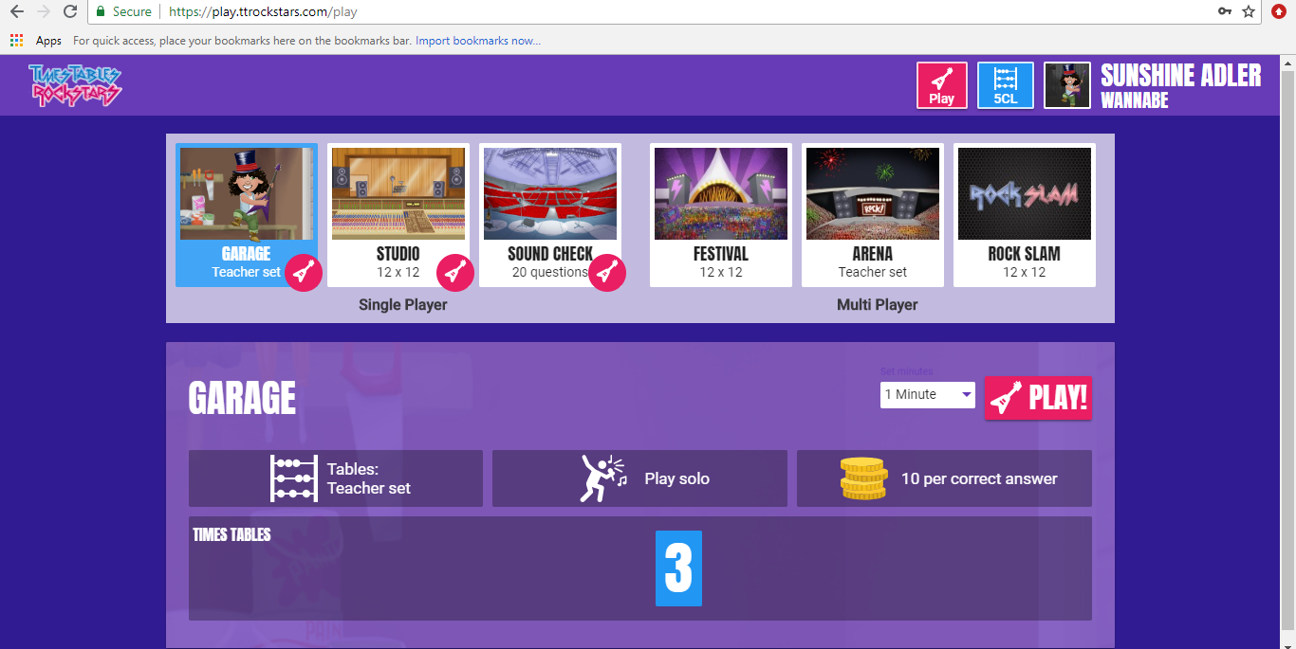
Set the timer for how long you want to play for and click Play on Garage mode.

Slide 21
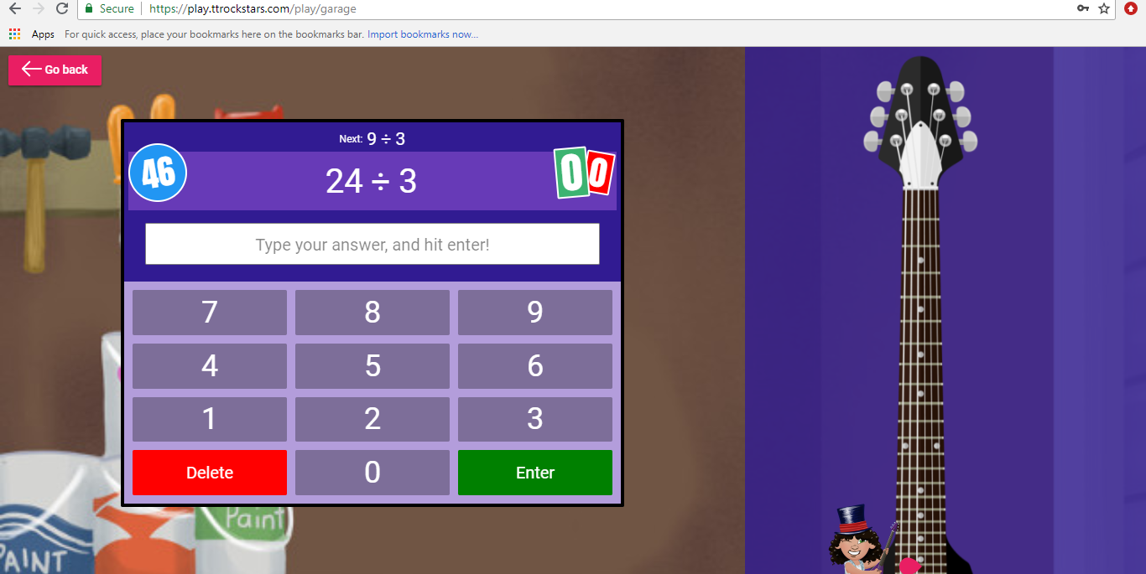
Type in each answer to the questions and press enter.

Slide 22
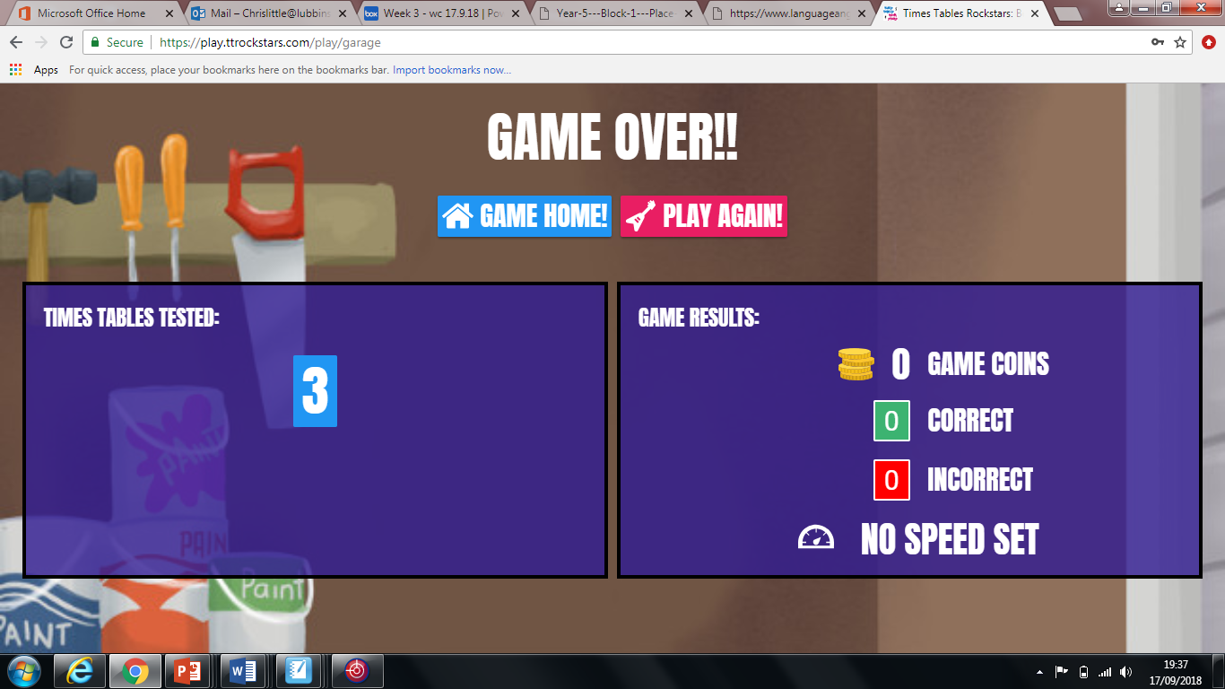
Once the game is over you will see your results and how many coins you have collected, then you can purchase something in the online shop for your avatar.
The expectation is that this site will be accessed once a week by each child for a minimum of 10 minutes.

Slide 23
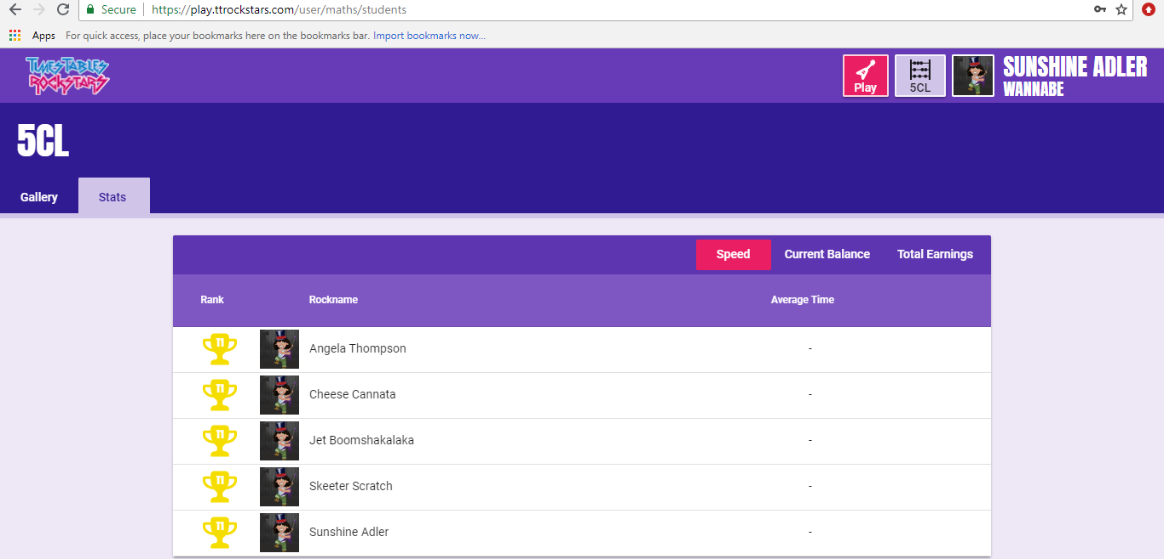
Click on your classes name at the top to see how you rank against your classmates.

Slide 24
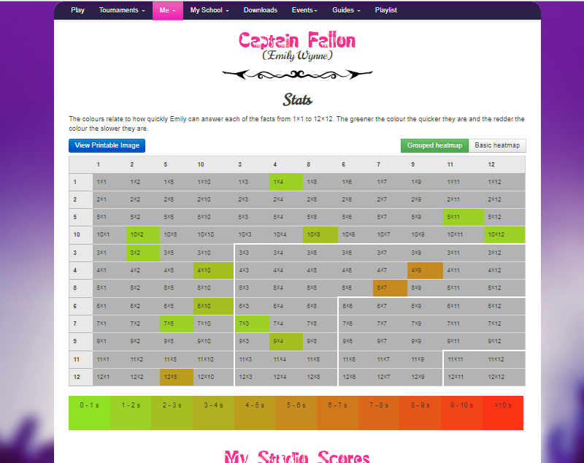
Click ‘Me’ and then ‘My Stats’ to reveal a heat map.
Any times tables which are red, indicate a times table to focus on.

Slide 25
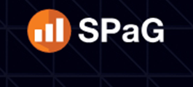
www.spag.com

Slide 26
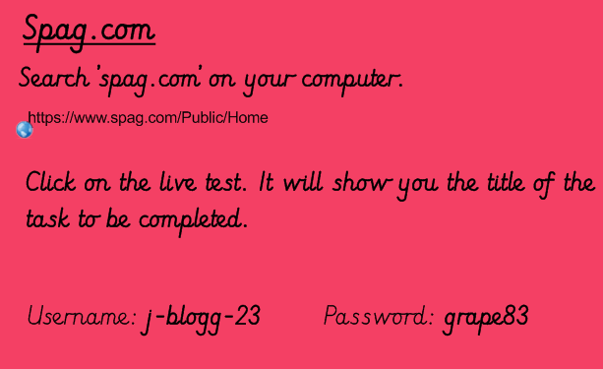

Slide 27
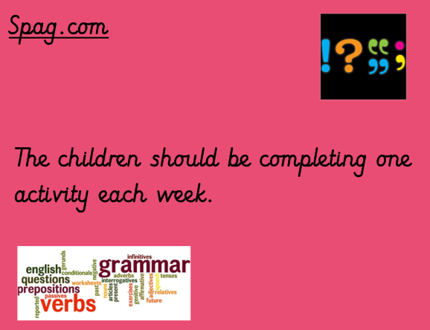

Slide 28
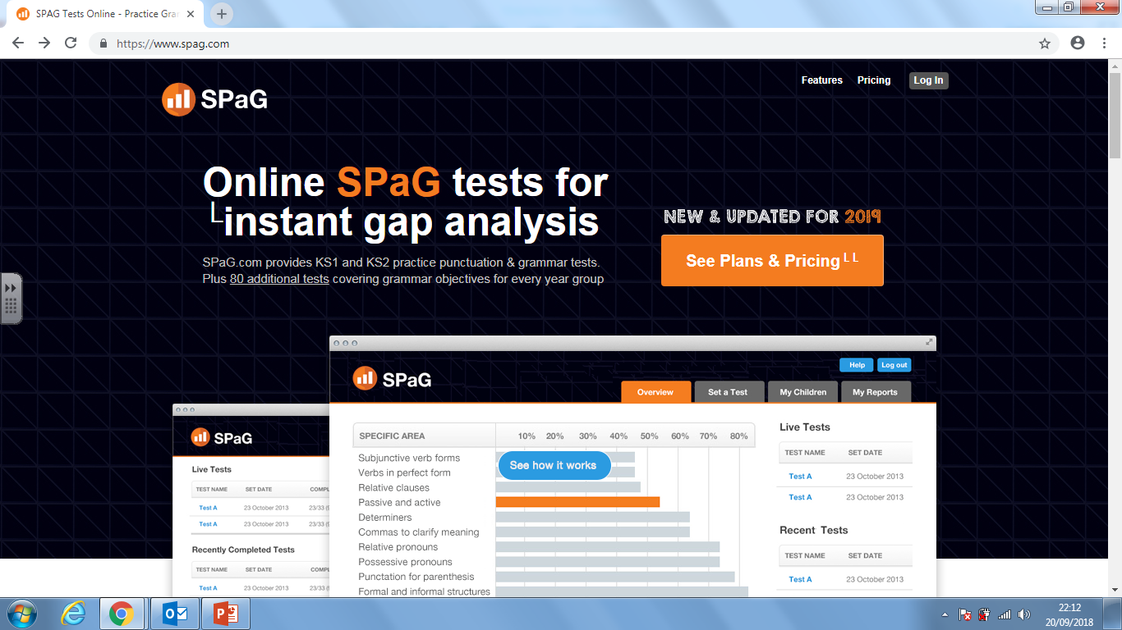
Type in spag.com in your web browser. You should see this screen when you first enter the website.

Slide 29
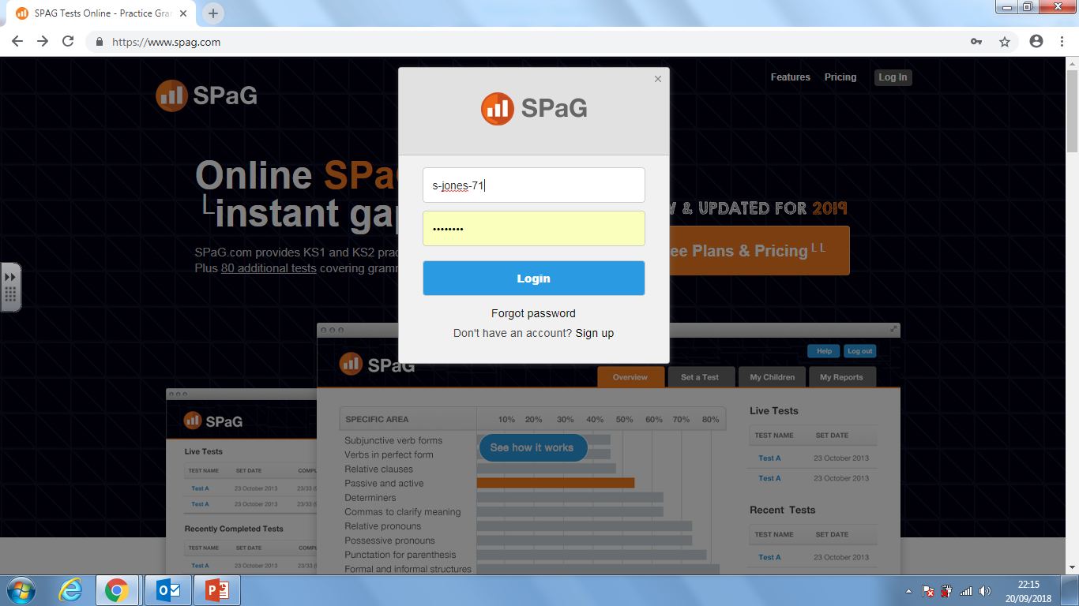
Click on the log in tab in the top right hand corner.
Enter your username and password.

Slide 30
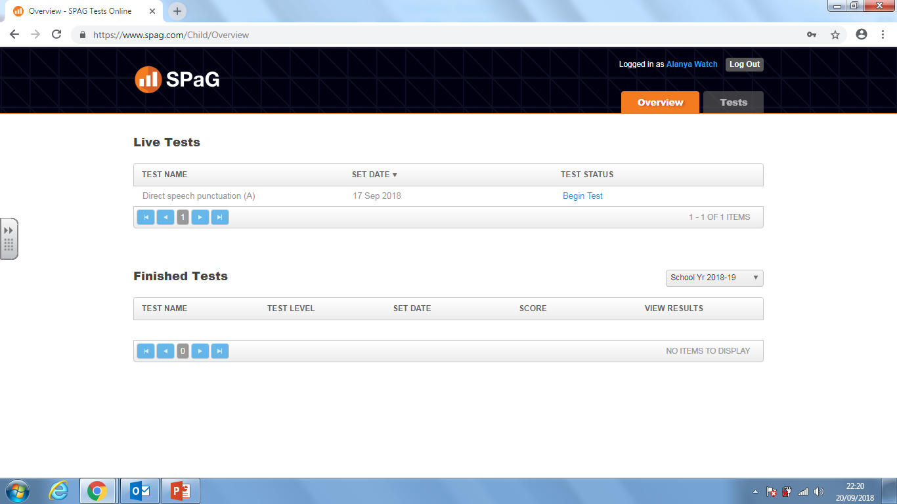
Students will be set tests by their teachers each week.
The live tests will be listed here (see below).
Finished tests will be listed here.

Slide 31
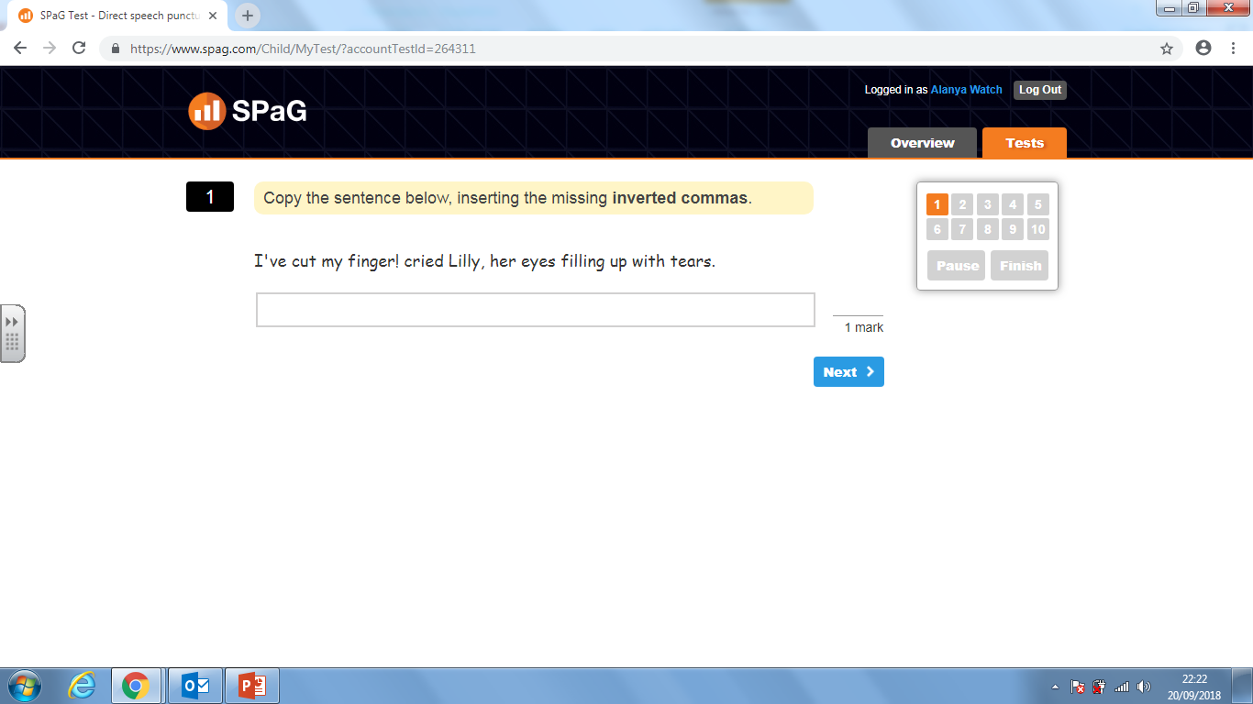
You can leave a test and go back to it later if you wish.
This is an example from a live test. Students type their answer into the box and click next.

Slide 32

This test has been started and stopped before it has been finished.
It says resume test so you can go back to it.
Teachers have an overview of what your child has been completing online.

Slide 33
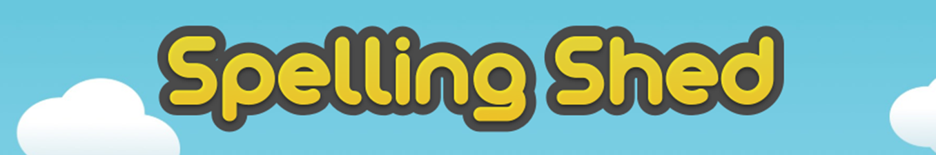
www.spellingshed.com

Slide 34
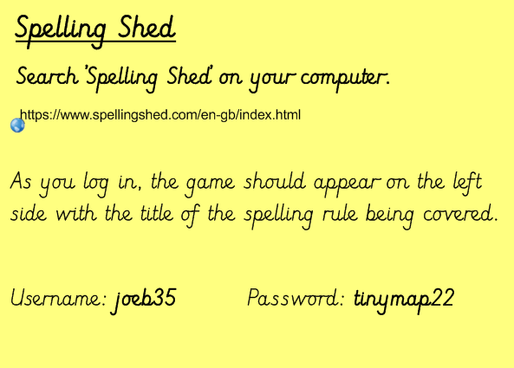

Slide 35
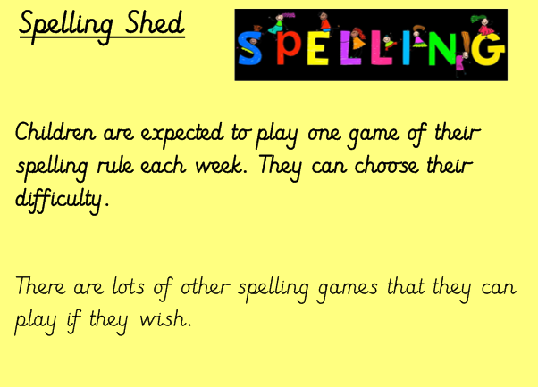

Slide 36

Once you have logged onto spelling shed, you can enter the child’s username and password, then press submit.

Slide 37
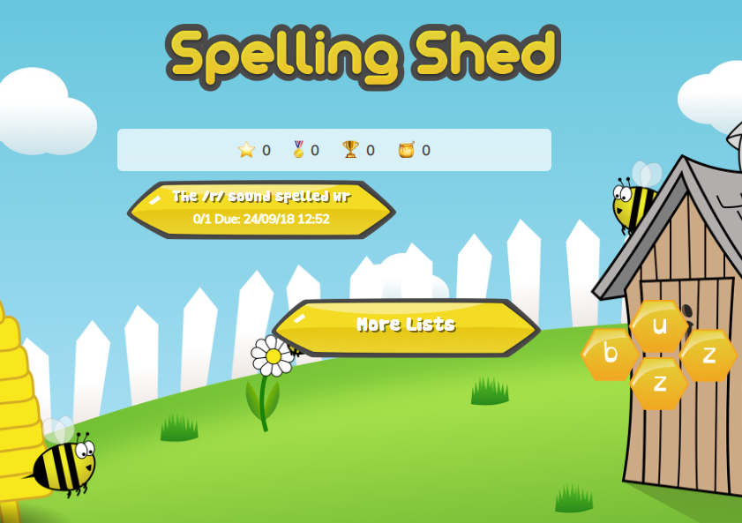
On the home screen page there will be the spelling list set by the class teacher.
The children click onto the task set and can begin to complete the challenges.

Slide 38
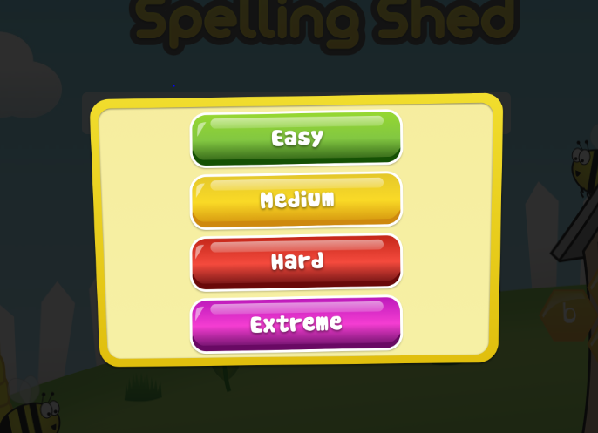
The children are asked for the level that they want to start the spelling challenges. Pick a level, if your child is not overly confident, perhaps start at an easier level and encourage them to work their way up!

Slide 39
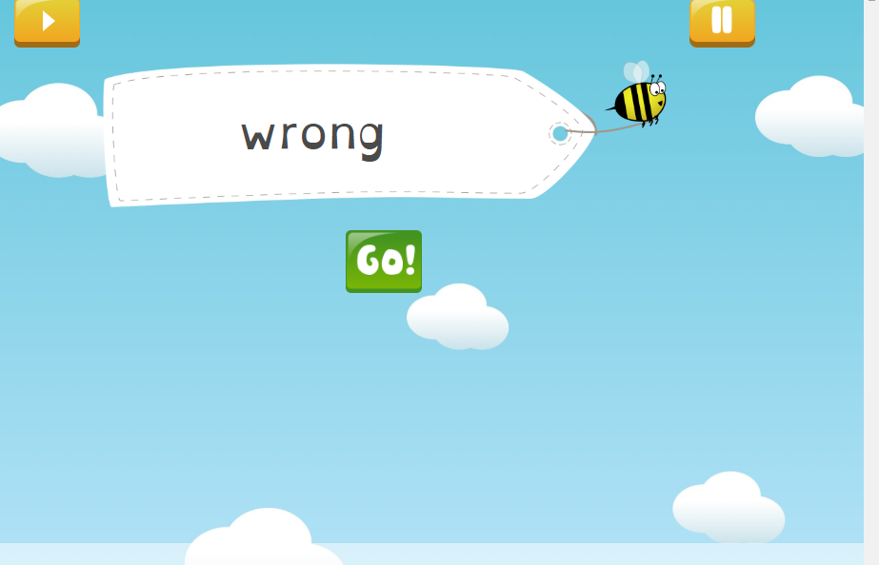
Here is the first screen telling you what word you need to spell – press go!

Slide 40
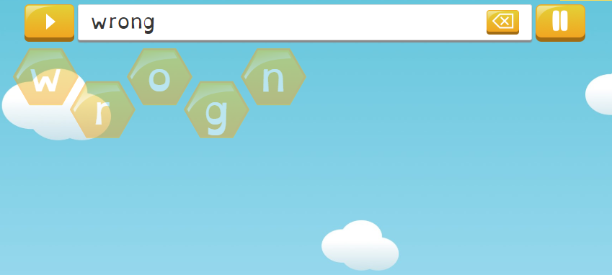
This is the chance for the children to start to spell the word using the given letters (depending on the level, the games will be differentiated to suit the child).

Slide 41
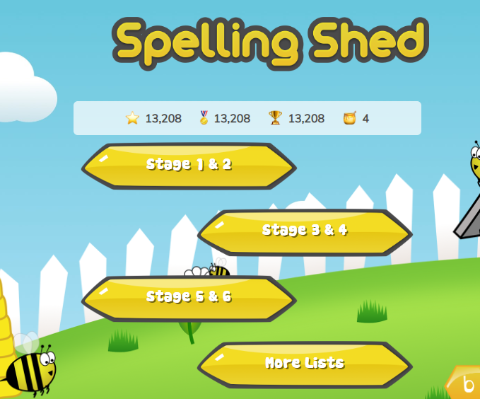
The children can see how many points they are gaining along the top of the home screen.

