Slide 1
RWI Phonics Parent Meeting
Notes:
Welcome to a brief taster of our whole school synthetic phonics literacy programme – Read Write Inc!
Please insert own notes for introduction/welcome.

Slide 2

Children who read at home do well at school
Read fluently
Write confidently
Speak articulately
Notes:
“Reading is the one ability, that once set in motion, has the ability to feed itself, grow exponentially and provide a basis from which possibilities are endless.” Michael Morpurgo

Slide 3
So, what is Phonics?
Learning to hear and read sounds.
Breaking words into sections to blend.
Parent video: Understanding Phonics - YouTube

Slide 4

Why Phonics?
A complete literacy programme - systematic and structured.
Meets the demands of the new national curriculum, giving your children the best chance of success in the national tests.
One-to-one tutoring - no child is left behind.
Storybooks align with the sounds learnt in class.
https://www.youtube.com/watch?v=sjlPILhk7bQ
Notes:
Read Write Inc. Phonics is systematic and structured –
every teacher has the skills to teach any child to read.
The programme meets the demands of the new national curriculum –
your children have the best chance of success in the national tests.
Assessment is rigorous and effective – one-to-one tutoring ensures that no child is left behind.
Your children are thoroughly supported – the resources match your child’s learning in class and they can share them with you at home.

Slide 5
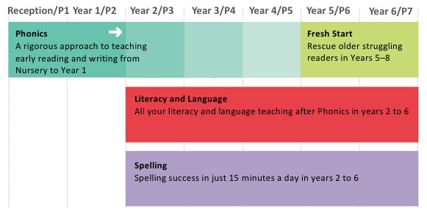
Who is Phonics for?
Notes:
Delete as appropriate to what happens in your school after Phonics.
Phonics is usually taught in Reception and Year 1 but many schools are enjoy early success in Nursery.
Most children should be fluently reading, without Phonics, by Year 2. These children move onto Read Write Inc. Literacy and Language.
Phonics is also great for older children who need to catch up and children new to English. These children use Read Write Inc. Fresh Start.

Slide 6
A bit of technical knowledge…
Phonics = the sounds in our language.
Watch the sound pronunciation guide:
https://www.youtube.com/watch?v=TkXcabDUg7Q
Now it is your turn to practise…
Notes:
This video is available on the RMT website and Facebook page

Slide 7
The English language is a complex code…
It would be easy if we only had to learn Set 1 and Set 2 sounds.
ay | igh
play eight cake straight | right spie kite fly
Set 3 sounds

Slide 8

How do we teach phonics?
Speed Sounds
The sounds are split up into 3 sets.
There are BOUNCY sounds…
…and STRETCHY sounds!
Parent video: Reading the bouncy sounds with your child - YouTube
Parent video: Reading the stretchy sounds with your child - YouTube
Notes:
Hold up Fred! Say you too can have a Fred at home – use one like this or any stuffed toy. Watch the video for a demonstration of how to Fred talk.

Slide 9
How do phonics help us read?
Say “hello” to Fred.
Fred can only talk in sounds...
He says “c_a_t.” Not cat.
We call this Fred Talk.
Watch Ruth Miskin explains Fred Talk.
Notes:
Hold up Fred! Say you too can have a Fred at home – use one like this or any stuffed toy. Watch the video for a demonstration of how to Fred talk.

Slide 10
How do phonics help us read?
Once the children have learnt some sounds, they can start to blend them to begin to read words.
Parent information video:
https://www.youtube.com/watch?v=MNyFikwNQTg

Slide 11
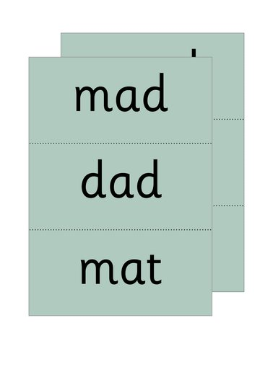



Word Time
Fred is not the only way we teach children to blend sounds.
We use the letter cards and magnetic letters.
This section of the lesson is called Word Time.

Slide 12
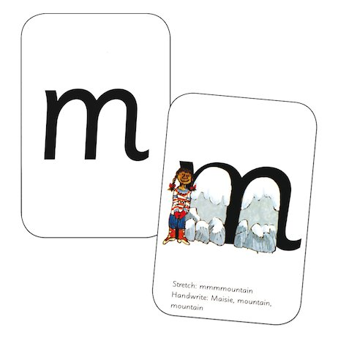
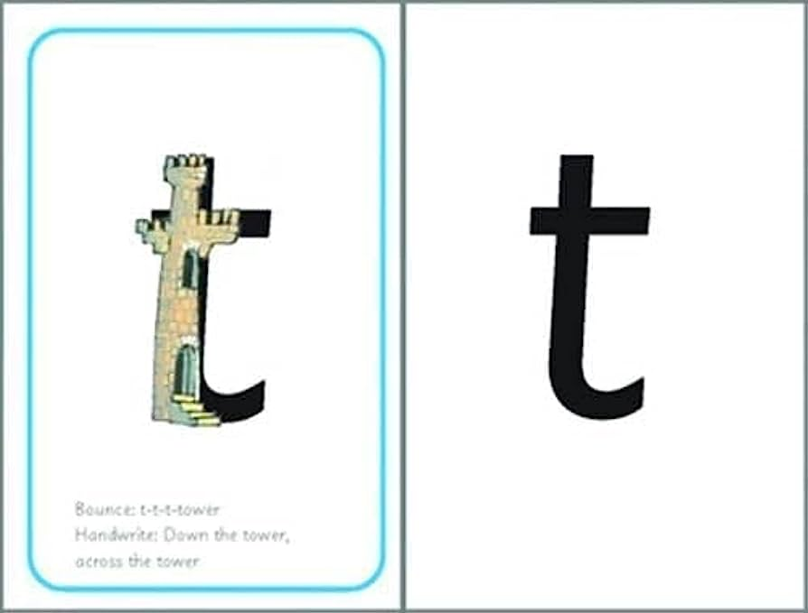
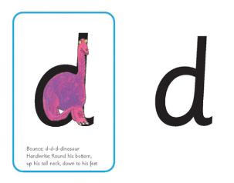
Writing
To help the children write the sounds we use a rhyme to help. These link to the letter pictures.
When the children write, they sit at desks. They are taught the correct sitting position and pencil grip.

Slide 13
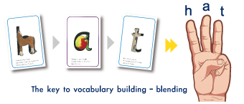
Writing
Once the children are secure writing some letters, as with reading, we begin to blend the letters to write some words.
Fred is back!

Slide 14
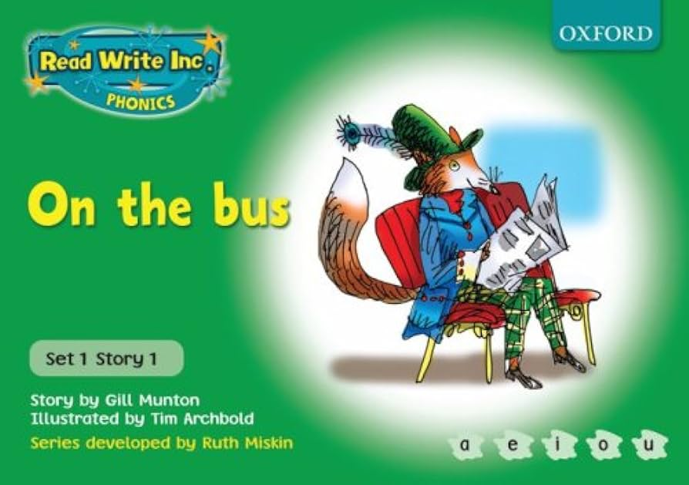
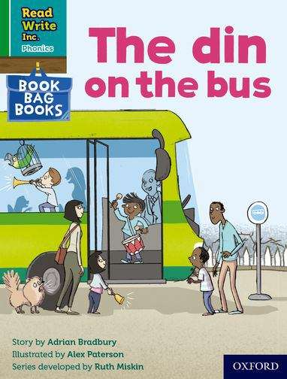
Reading
Children read books that contain only the sounds they know.
They read a book in class with a partner. This book is matched to the sounds they know.
They read the book 3 times:
First read – decoding
Second read – fluency
Third read – comprehension
They also bring a book home to practise.

Slide 15
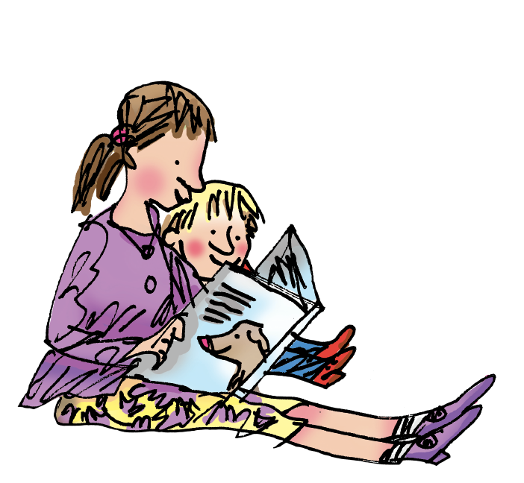
Reading
The books do not look very exciting, but the aim of the programme is to build basic skills and confidence.
Reading for pleasure is vital though and children must experience the joy of a great book!
So that we help our children to build basic skills, grow in confidence and enjoy reading, your child will bring home a selection of reading books and one ‘aspirational’ book.

Slide 16
Reading
RWI teaches children the skills they need to ensure they become confident readers and writers.
Stage not age – their reading book is matched to their ability.
Assessment it continuous. If a child falls behind, then support is given.
Home practise is vital – we need to work together

Slide 17
You can read stories with your child. Relentlessly!
Read favourite stories over and over again
Read some stories at a higher level than they can read themselves.
Listen to them reading their take home Phonics storybooks.
Notes:
View the Ruth Miskin Training suggested reading lists for great books to read with your children.
http://www.ruthmiskintraining.com/teacher-support/tag-44/index.html

Slide 18
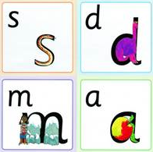
You can practise pronouncing sounds.
Remember no ‘fuh’ and ‘luh’!

Slide 19

You can have fun with Fred Talk.
“What a tidy r-oo-m!”
“Where’s your c-oa-t?”
“Time for b-e-d!”
Notes:
Give a couple of examples e.g. Where is your c_oa_t? Time for b_e_d! Make sure your child can tell you what the word is.
Use only single syllable words (no Fred Talking multi-syllabic words) and only the last word in a sentence or it gets very silly! E.g. P_u_t o_n y_our b_l_ue c_oa_t (you’ll never get out!).

Slide 20



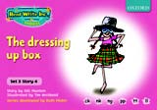





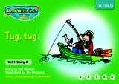


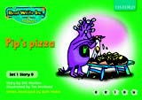


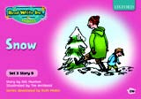



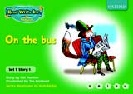




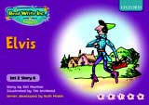
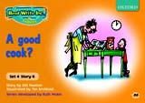

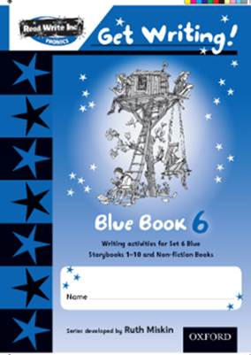
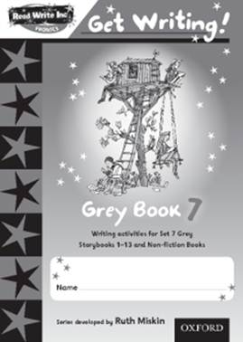
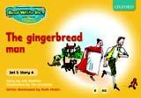

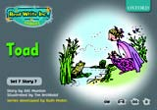
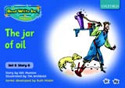
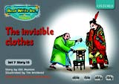
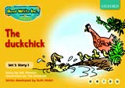
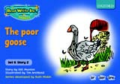
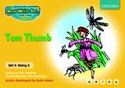


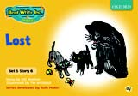
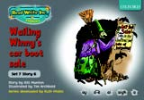
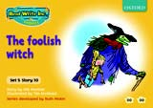

Oxford University Press publish the resources

